Slide 1
News Web application
USING AWS SERVICES
Omar El-Damrany
Mostafa Mohamed Kamal
Yasmine Fayed
Lubna Mohamed

Slide 2

Introduction
Knowing the news of many countries requires a web application, that and including AWS services with it can provide a better experience in that matter, this project is the implementation of AWS services with a web application for worldwide news.

Slide 3

User Interaction
User friendly
Quick & accessible
Worldwide news coverage
Simple design
- User basically enters the topic which they require news about, they may also select whether they’d like to search for news internationally or only inside Egypt.

Slide 4
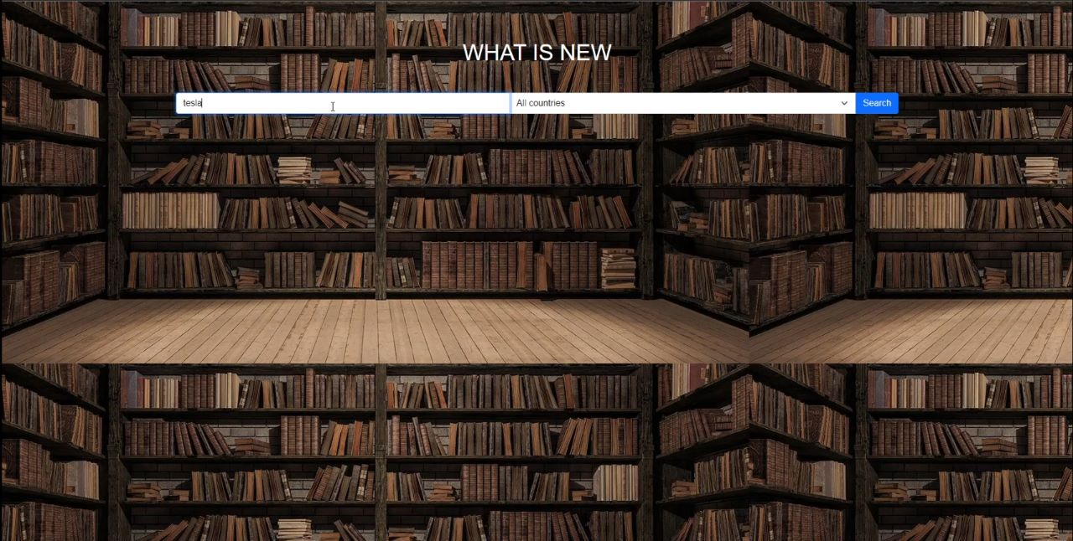

Slide 5
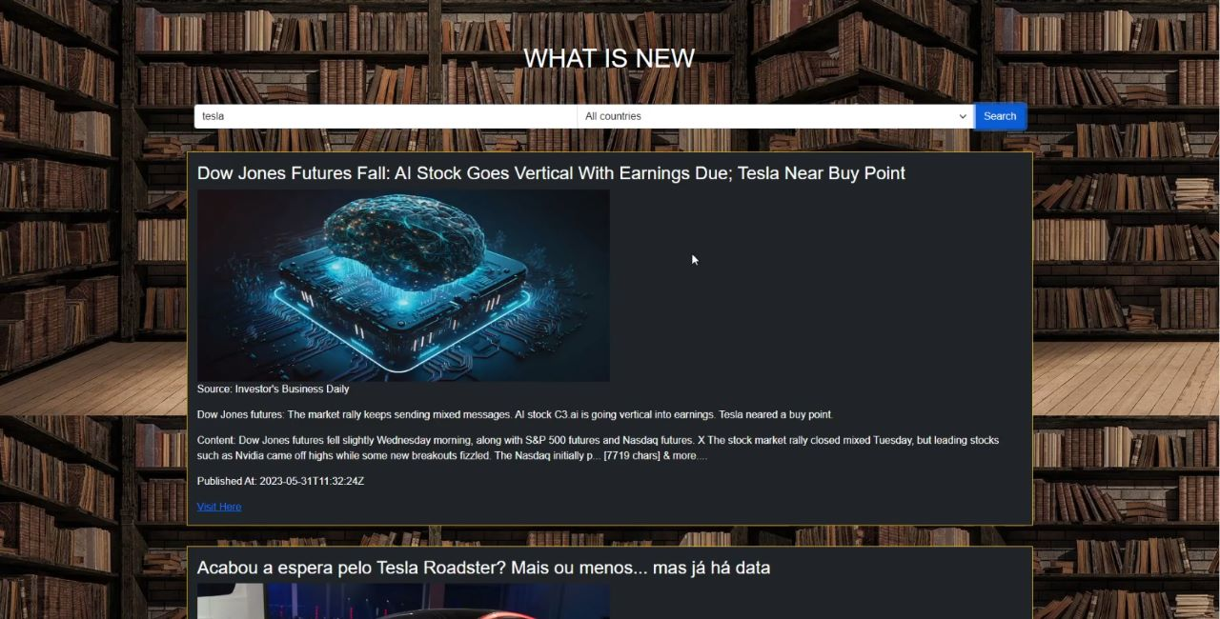

Slide 6
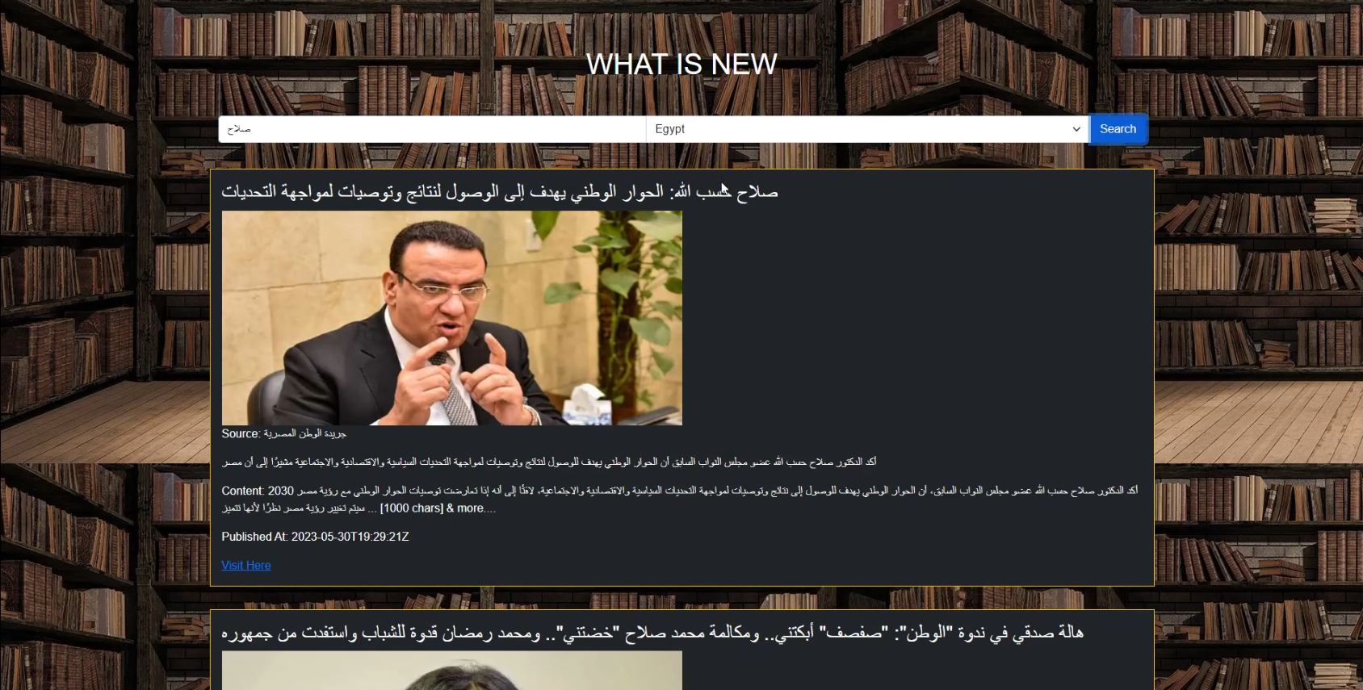

Slide 7
AWS Services
Cloud9
An IDE that was used to type and run our code as in frontend and functionalities and potentially backend.
S3
Used as a storage to keep all your data files regarding the web application.
SNS
Used to send notifications (alerts), was used in our web application to notify the admin by email if any updates were to happen in the S3 bucket.
CloudFront
Used to launch, secure and deploy the web application stored on S3 bucket and provides a URL that can be used by any user from any location.

Slide 8
Service Scaling
Using current services
Future services
Cloud9 IDE can be used to further implement updates to the web application.
S3 will continuously store all updated files and data.
SNS will continuously send notifications regarding any updates to the S3 bucket.
Route 53 can be implemented to provide DNS for a certain URL (domain name) for the website instead of CloudFront’s randomized one.
Multiple services can be implemented to provide security, analytics or AI for recommendation systems or others.

Slide 9



Summary
As no external hardware or dataset is required, the web application using the AWS services will work quite fluently without disturbances, fetching from a news API and displaying results to the user smoothly.
Further updates can easily be implemented, stored and the admin will be notified, all while the website is deployed.

Slide 10




Thank you
Omar El-Damrany
Mostafa Mohamed Kamal
Yasmine Fayed
Lubna Mohamed

